Slide 1
Welcome to
Presentation Session of Research

Slide 2
OUR TOPIC
Movie Recommendation System

Slide 3
Supervisor
Roksana Akter
Assistant Professor
Dept. of Computer Science and Engineering
Southeast University
Group Members
Name ID
Sourov Das Tomal 2018200000034
Farhana Habib Tamanna 2018200000036
Tanzim Hasan 2018200000038

Slide 4
1
Objective
Improve revenue by solving recommendations problems
Build a recommendation system

Slide 5
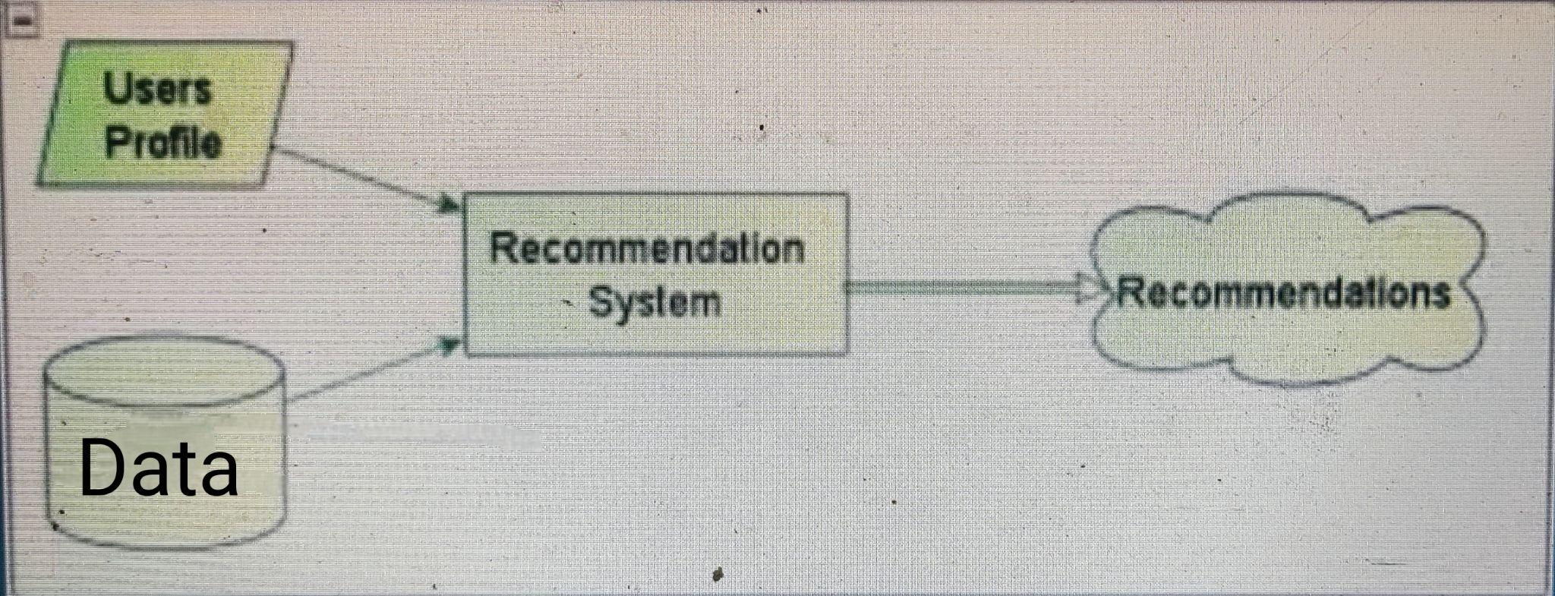
Introduction
2

Slide 6
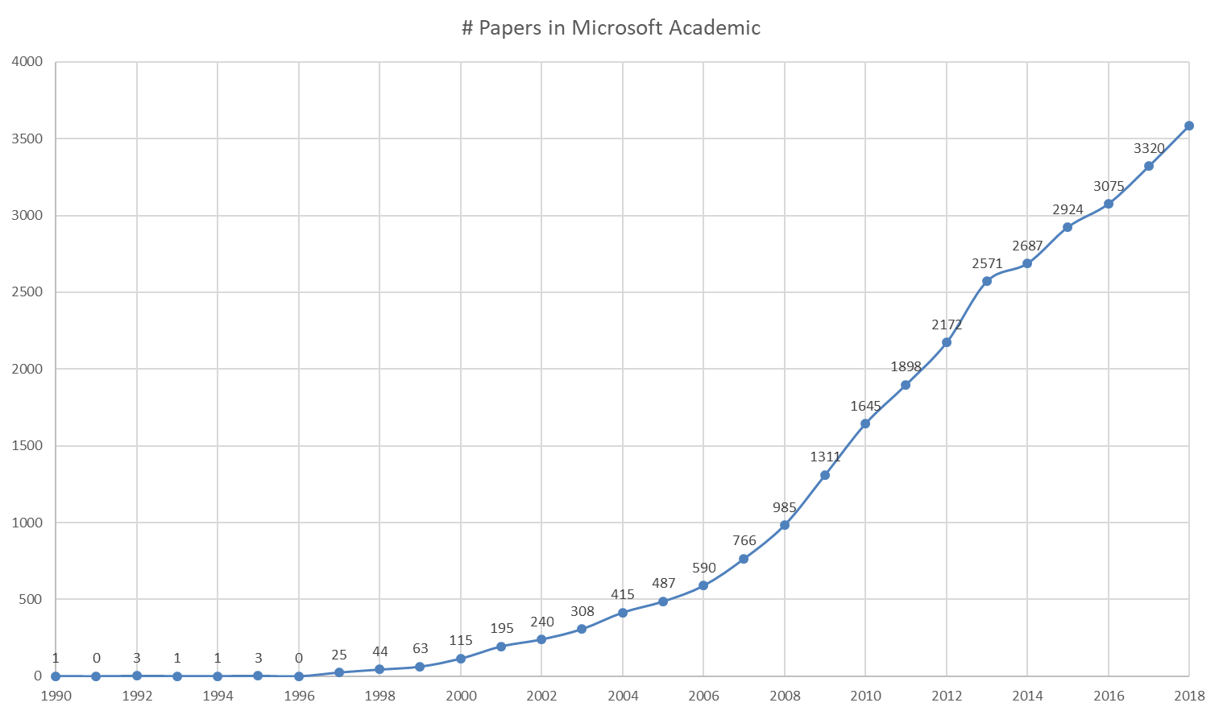
The rise of recommendation system
33

Slide 7
Literature Review/Background Study
4
“Research Problems in Recommender systems ”
“A content based movie recommender ”
“A personalized movie recommendation system based on collaborative filtering ”
“ A Review of Movie Recommendation System: Limitations, Survey and Challenges ”
Help users in finding new films and TV shows
Saves time and effort for the user
Making their movie watching experience more enjoyable.

Slide 8
Methodology
5
Workflow -1
Data Collection
• kaggle
Data pre-processing & Feature Extension
• Remove unnecessary column
• Drop( missing,duplicate data)
• Formatting Keywords ( cast top 3/crew director )
• Combine them ( one tag )
• Vectorization ( Bag of Words )
Matrix 5000
Stopwords

Slide 9
6
Remove similar words (steming)
• Loved - Loving - Love
User Input
Cosine similarity
List of movies

Slide 10
7
Workflow -2
Data
Making data frame (pivot)/ u_id,m_id
Convert data frame to matrix (csr)
KNN,Cosine Similarity
List of movies

Slide 11
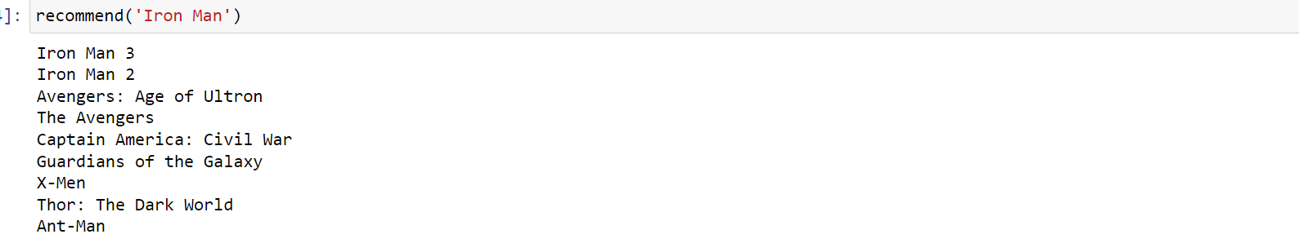
Result
8
Workflow - 1 output

Slide 12
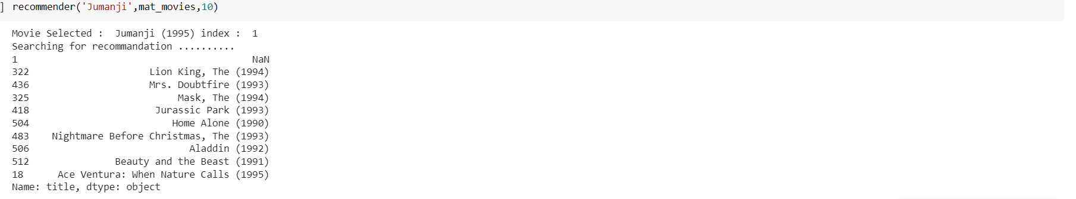
9
Workflow -2 output

Slide 13
Future work
10
Create a website platform
Build a hybrid Recommendation system
Can be useful for all users

Slide 14
Limitation
11
It can recommend only the datasets movie
Manually adding the new movies details

Slide 15
Conclusion
12
Recommend the similar type of movies
Used knn algorithm and cosine similarity

Slide 16
References
13
[1] Singla, R., Gupta, S., Gupta, A., & Vishwakarma, D. K. (2020, June). FLEX: a content based movie recommender. In 2020 International Conference for Emerging Technology (INCET) (pp. 1-4). IEEE.
[2] Subramaniyaswamy, V., Logesh, R., Chandrashekhar, M., Challa, A., & Vijayakumar, V. (2017). A personalized movie recommendation system based on collaborative filtering. International Journal of High Performance Computing and Networking, 10(1-2), 54-63.
[3] Cui, B. B. (2017). Design and implementation of movie recommendation system based on Knn collaborative filtering algorithm. In ITM web of conferences (Vol. 12, p. 04008). EDP Sciences.
[4] Rajarajeswari, S., Naik, S., Srikant, S., Sai Prakash, M. K., & Uday, P. (2019). Movie recommendation system. In Emerging Research in Computing, Information, Communication and Applications: ERCICA 2018, Volume 1 (pp. 329-340). Springer Singapore.

Slide 17
Thanks everyone

